Slide 1
DESIGN OF AN INTELLIGENT SYSTEM FOR THE AUTOMATED GREENHOUSE CONTROL
Members:
Escobar Villa, Andrés David 06200075
Gonzales Aburto, Ricardo Daniel 18200061
Huamani Avendaño, Dulce 18200219
Molina Yupanqui, Flor 18200164
Palomino Loa, Junior 18200172
Quispe Vega, Anthony Yair 18200179
Vera Leon, Bryan 18200124

Slide 2
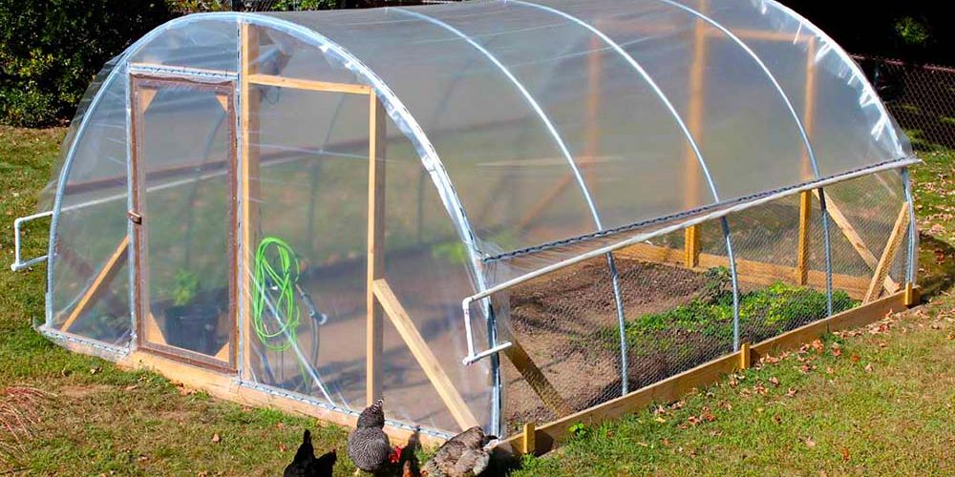
A greenhouse is a structure that is covered by transparent materials, where it is possible to grow plants or vegetables outside of your season and ensure a food availability throughout the season year.
Introduction

Slide 3
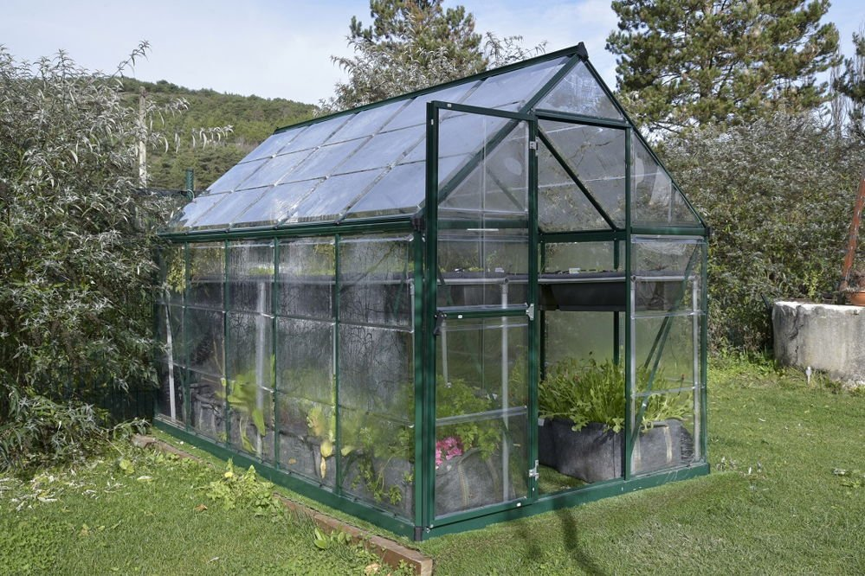
Objectives
General: Design and implement an intelligent modular system that allows efficient control of a greenhouse.

Slide 4
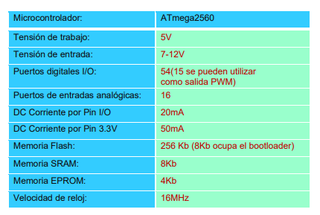
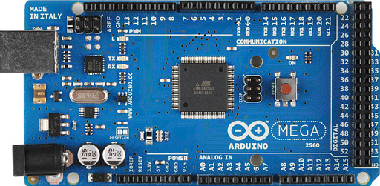
Arduino device used
Characteristics
Arduino Mega 2560

Slide 5
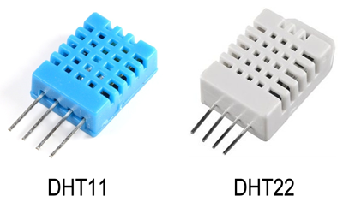
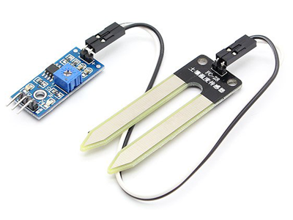
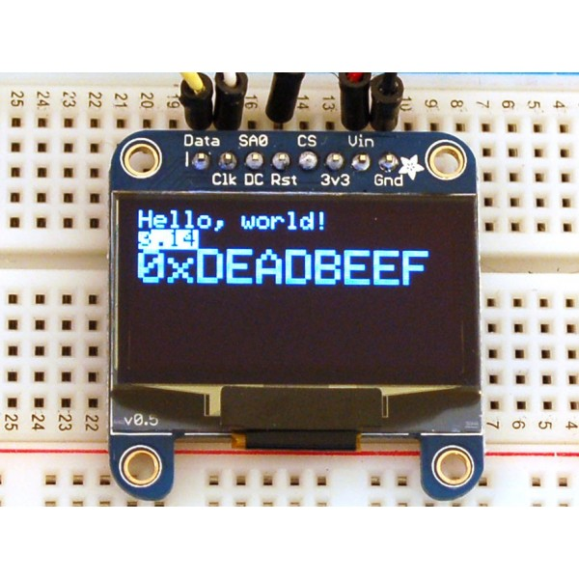
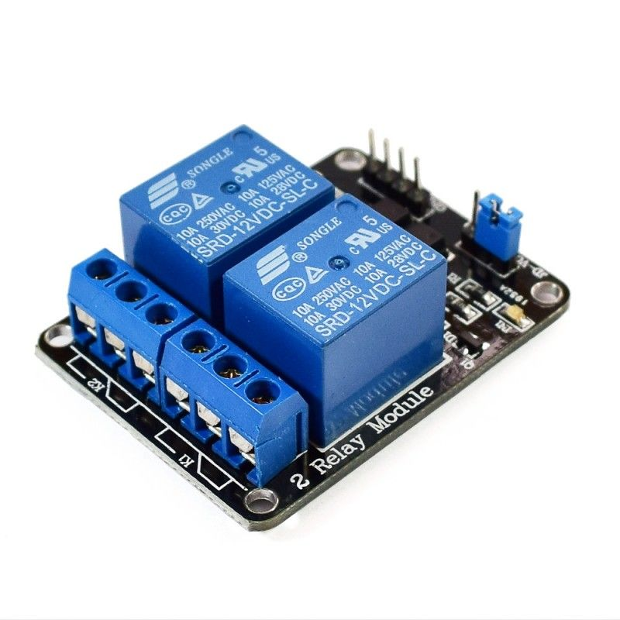
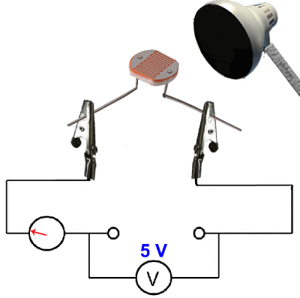
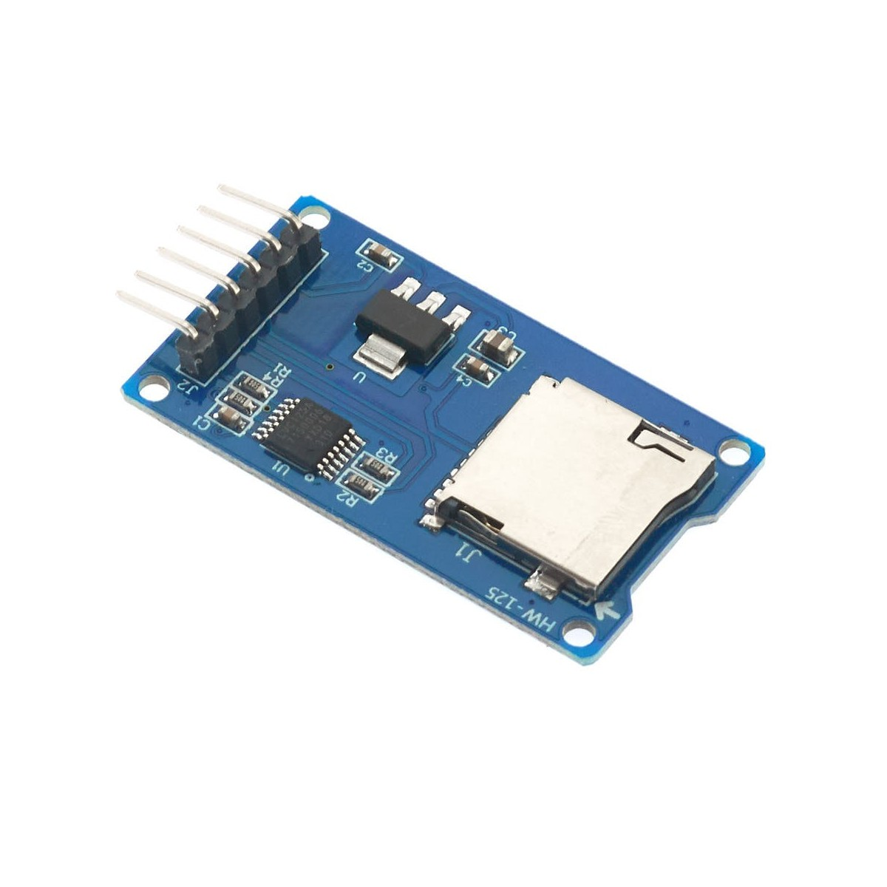
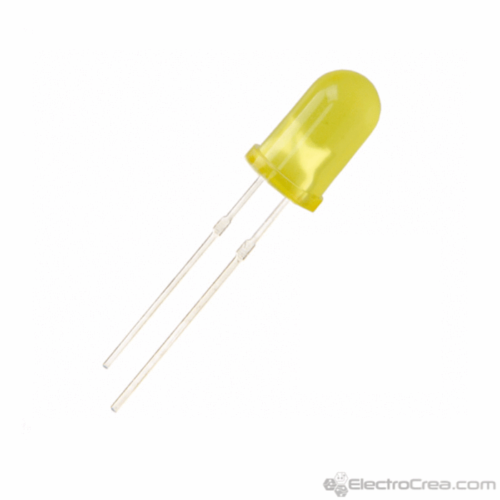
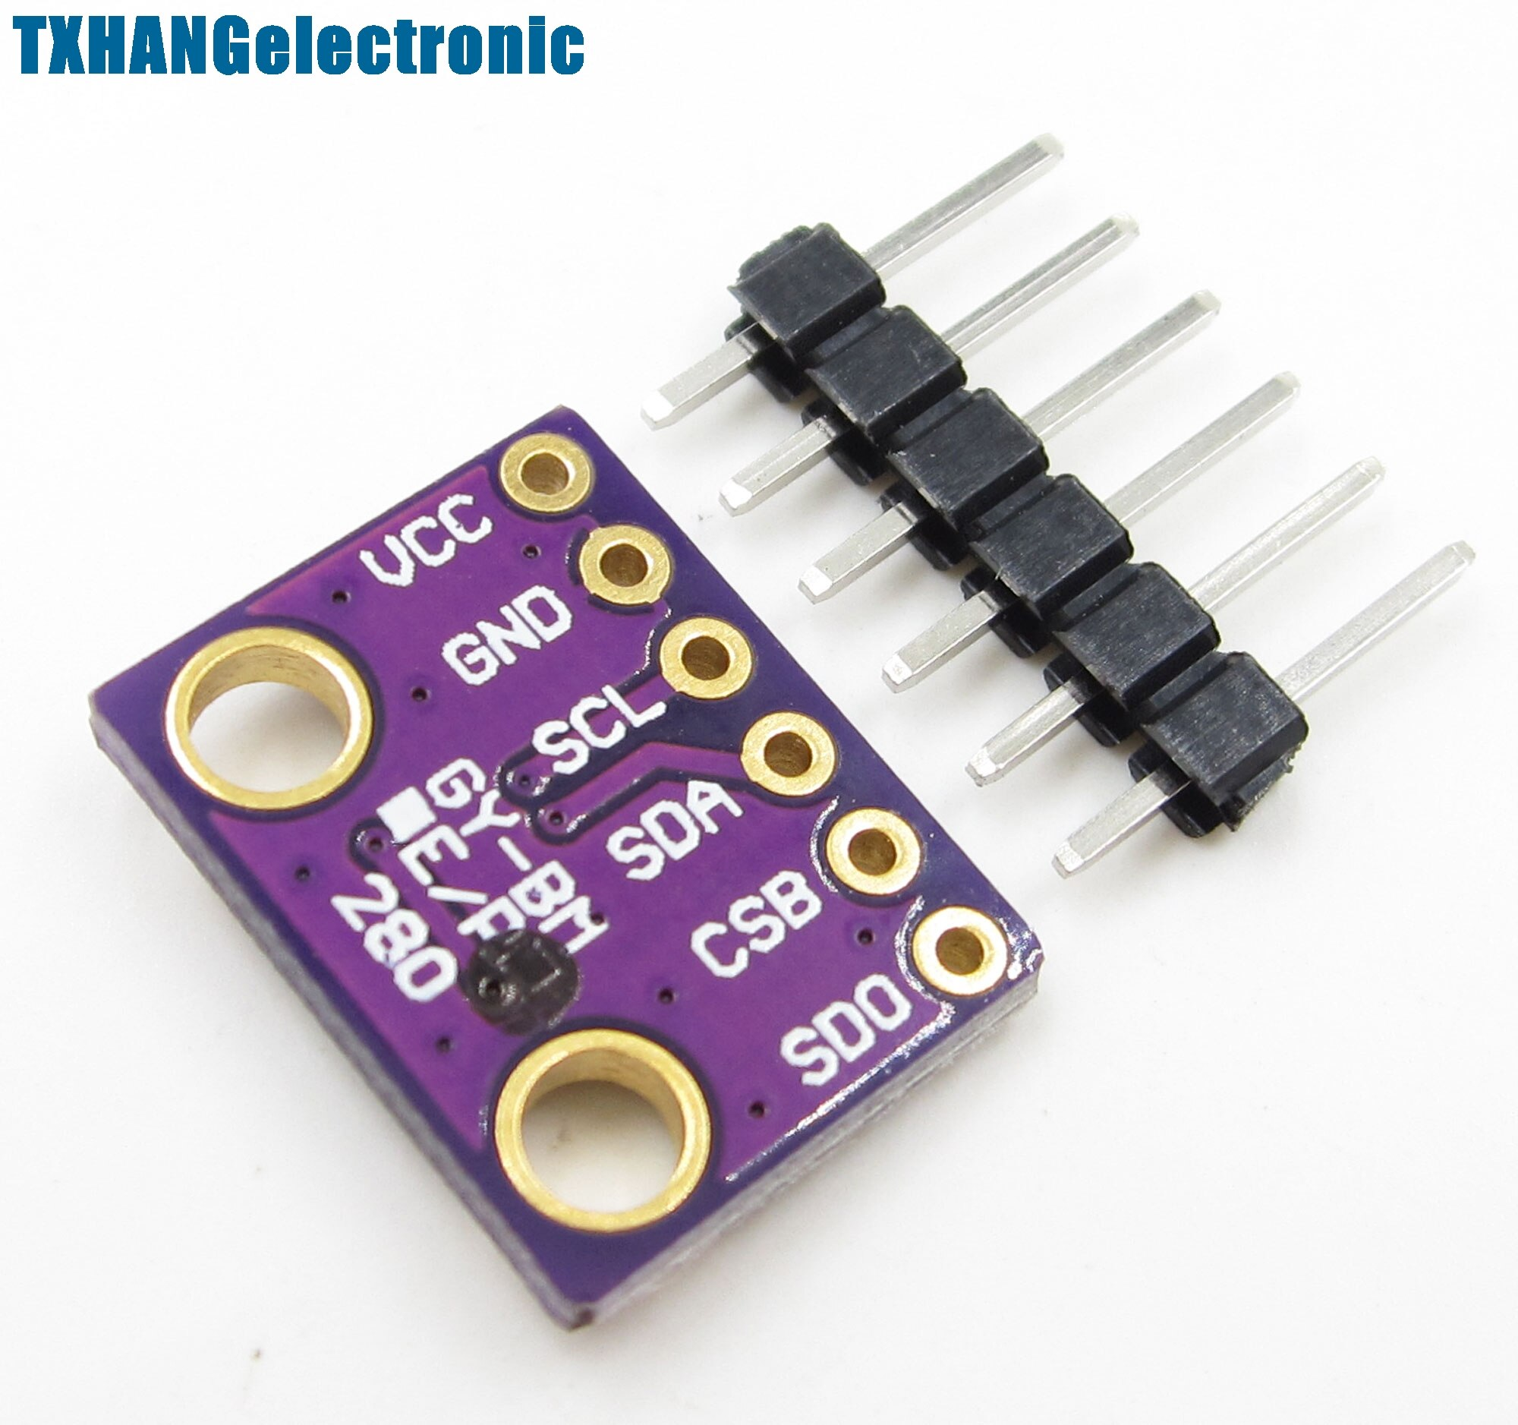
Devices used
SENSORS
DHT11 y DHT22
Mini Oled SS1306
Module Relay
FC-28
BPM280
Module Micro SD
LED
LDR

Slide 6
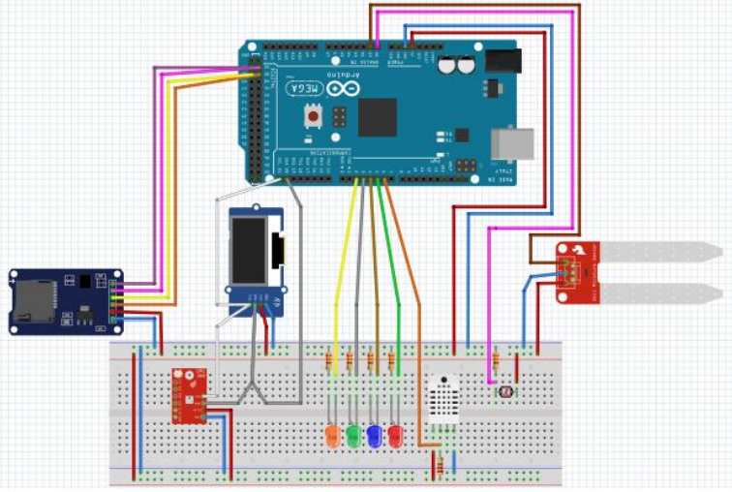
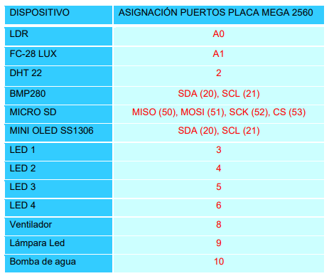
CIRCUIT ASSEMBLY
Assembly and connection of components
Arduino Mega 2560 on-board port assignment

Slide 7
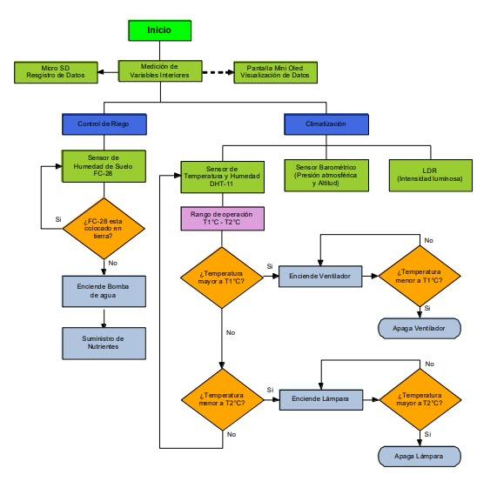
Flowchart

Slide 8
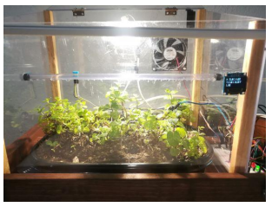
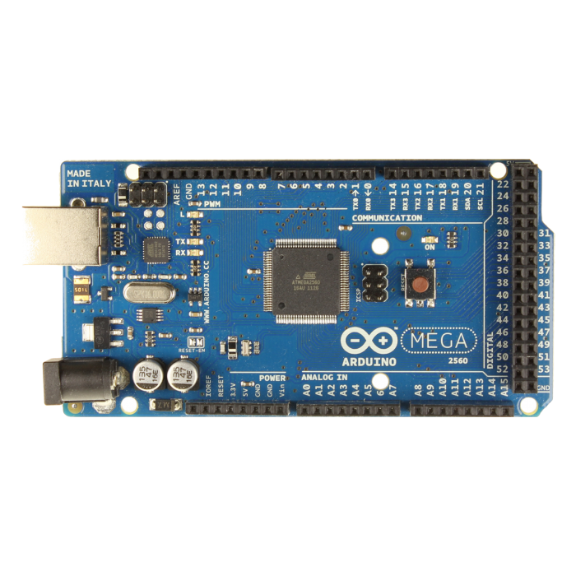
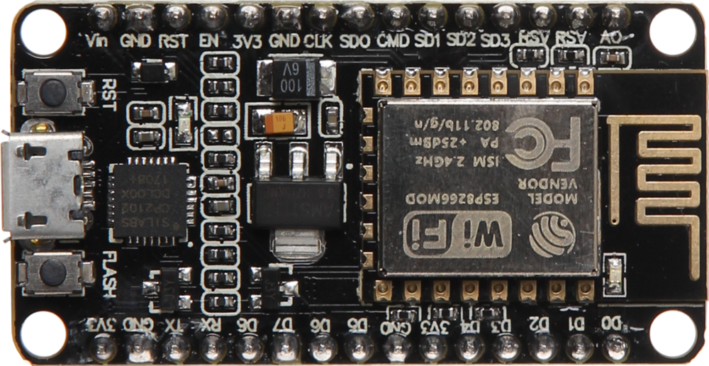
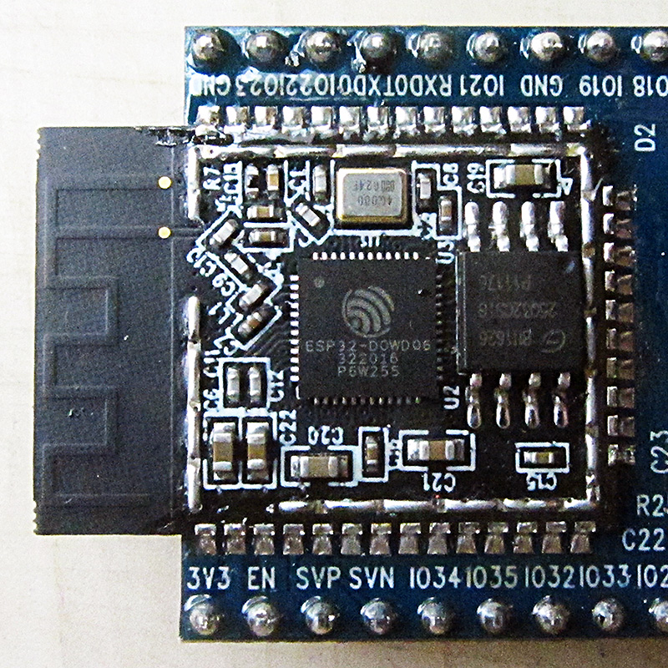
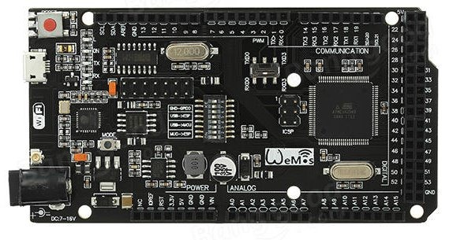
RESULTS AND CONCLUSIONS
Connection Options
☒ Arduino Nano
☒ Arduino Uno
☑ Arduino Mega2560
Modular greenhouse system
NodeMCU
ESP32

